Slide 1

PROLOGIC SOLUTIONS https://prologic.co.in/
ONE STEP SOLUTION
We Provide IT & Security Solutions for your
Home & Business Requirements

Slide 2



We are Experts in
Security Solutions
CCTV Surveillance Systems
Fire Alarm Systems
Anti-Theft Solutions
Home Automation Systems
Intruder Alarm Systems
Access Control & Biometric Systems
Electrical & UPS Works(sale & service)
Guard Monitoring Systems
IT Solutions
Computer Sales & Services
Designing & Implementation
of Networking
AMC Computer
Hardware & Networking
Barcode Solutions
EPABX Solutions

Slide 3

Our Profile
PROLOGIC SOLUTIONS is a complete IT & Security Solution Providing Company with a vision for providing reliable and cost effective solution for your Industrial and Residential Requirements.
We provide CCTV , Intercom and Biometric Access Control Systems and Integrated security Solutions for the safety of all your needs
We are also Computer Hardware professionals who take care of the Sales & maintenance of computer hardware.

Slide 4

Our Focus
Banks & ATMs
Hospitals
Educational Institutions
Corporate offices
Industries
Warehouses
Retail & Hospitality
Jewelry Stores
Apartments & Residences
Construction Sites
Petroleum Stations
All Electrical work sales & service
Shopping Malls and many more..

Slide 5

Business Portfolio
All CCTV Surveillance Systems : CCTV Camera Security Systems are quickly becoming an important aspect in Human Life.
Access Control Systems : Any system or method which automatically controls the passage of people and vehicles into or out of an area or structure
Fire Alarm Systems : A Fire Alarm Security System is an active fire protection system that detects fire or the effects of fire, and as a result provides one or more of the following: notifies the occupants, notifies persons in the surrounding area, summons the fire service, and controls all the fire alarm components in a building

Slide 6
Business Portfolio
Burglar Alarm : Burglar (or intrusion) safety alarms are electronic alarms designed to alert the user to a specific danger
DVR / NVR : Digital and Network Video Recording records video in a digital format to a disk drive, USB flash drive, SD memory card or other local or networked mass storage device
Network Solutions : An IP address is an identifier for a computer or device on a TCP/IP network.
Home Automation : Systems to control basic home functions and features automatically and sometimes remotely. An automated home is sometimes called a smart home

Slide 7
Business Portfolio
VIDEO DOOR PHONE : Would you like to know who is at the door before you let them in? Using Video Door Phone lets you see who is knocking at your door before you open it.
Video Conferencing Equipment : To conduct a conference between two or more participants at different sites by using computer networks to transmit audio and video data
Biometric Access Control Systems : Measuring and analysis of such physical attributes as facial features and voice or retinal scans. This technology can be used to define an individual's unique identity, often for security purposes
3G Boosters / Mobile Jammers /Signal Boosters

Slide 8
Business Portfolio
Computer Hardware Sales & Services
We Offer a full range of Hardware Sales and Services for Businesses, as well as individuals. With the support of our team of highly qualified technical and commercial professionals, we are able to provide a series of comprehensive and competitive solutions and services supporting our clients across the region

Slide 9

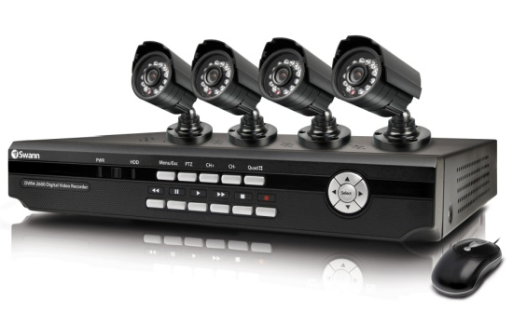
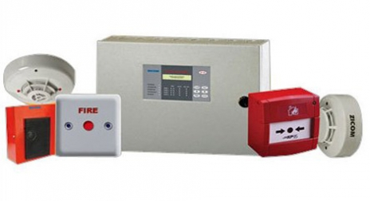
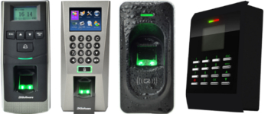
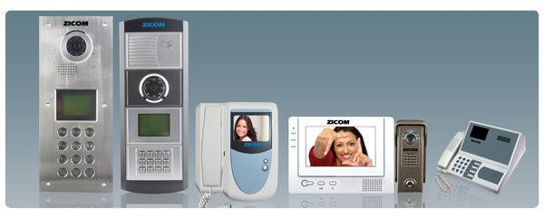
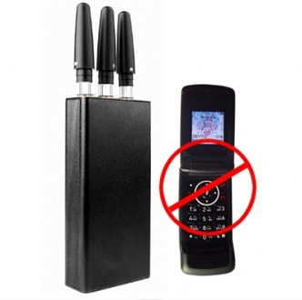
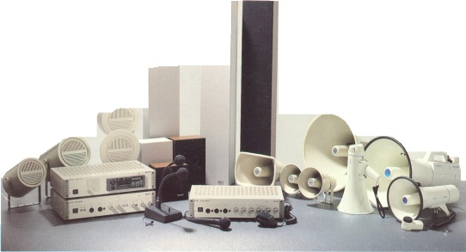
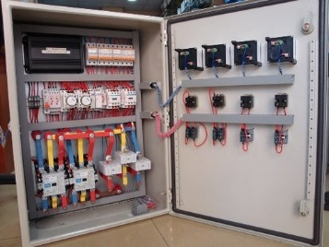
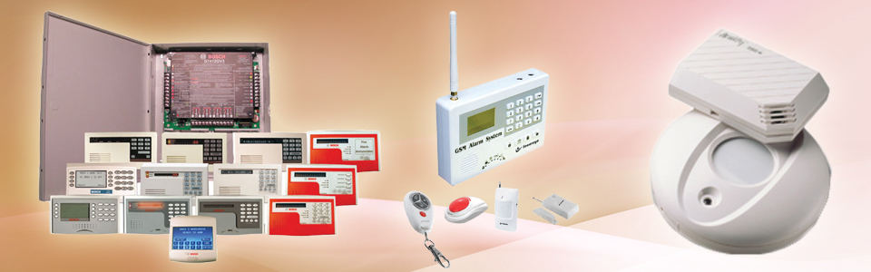
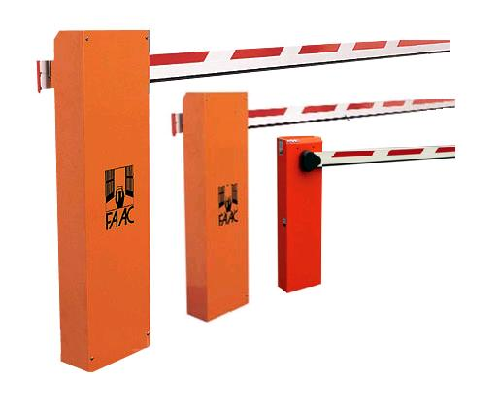
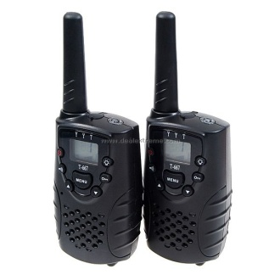
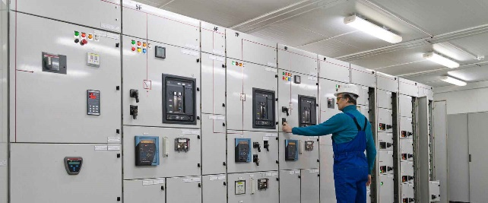
Security System Products

Slide 10
















Our Security Brands

Slide 11

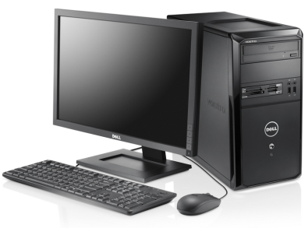

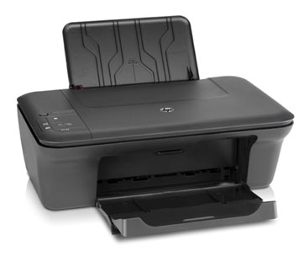
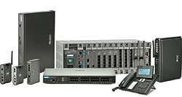
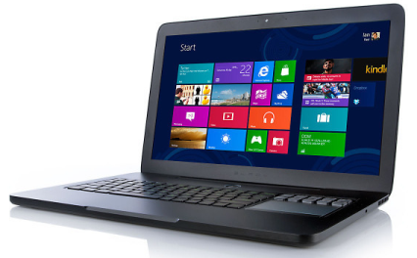

Our IT Products & Brands
Antivirus

Slide 12
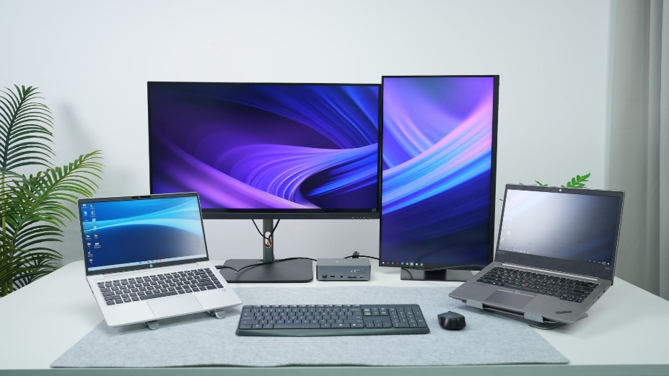
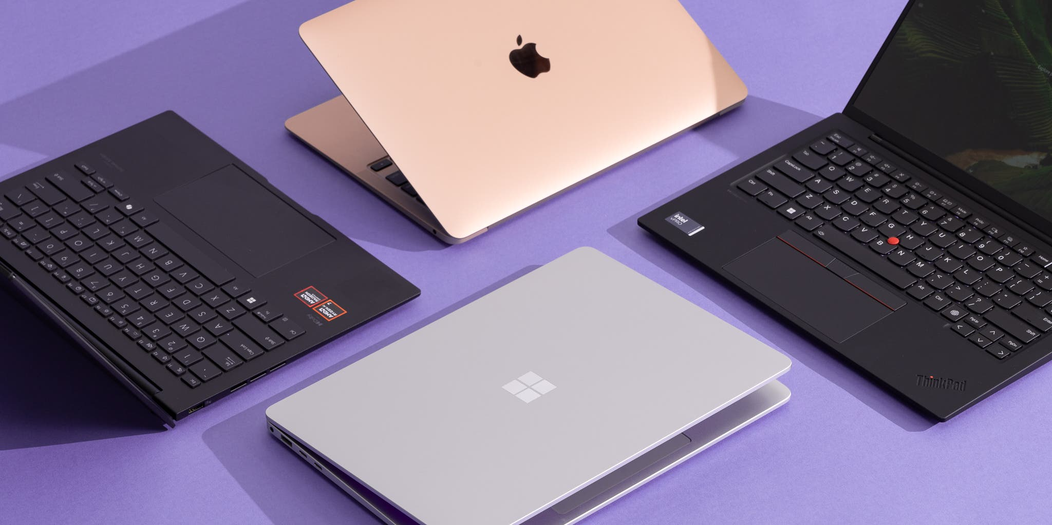
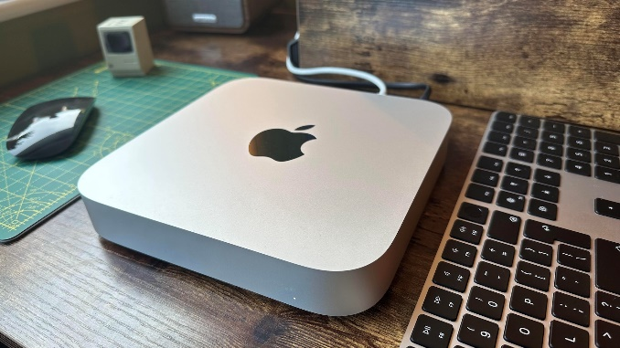
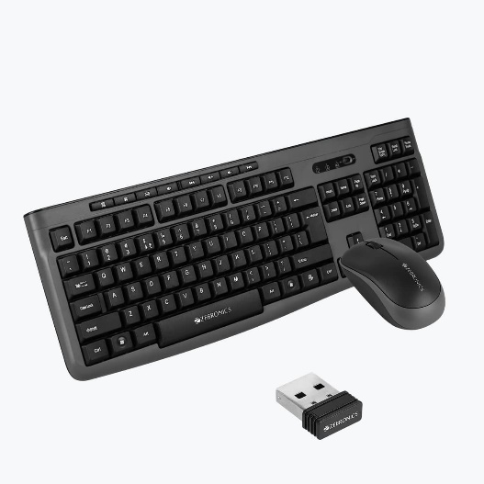

Our IT Products

Slide 13























Our Clients

Slide 14
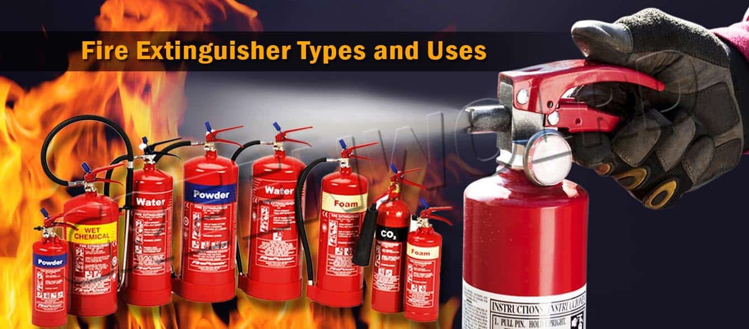
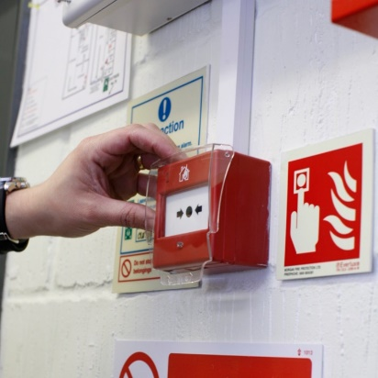



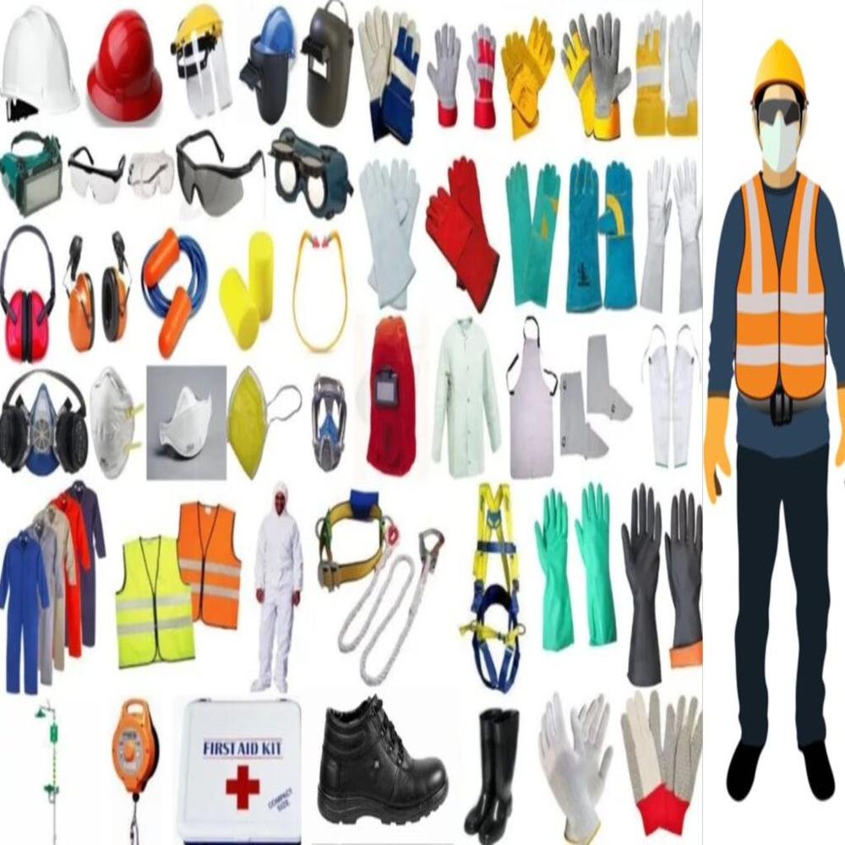
Gallery

Slide 15

Contact Us
PROLOGIC SOLUTIONS
#672,1st floor,2nd block,Landmark : Navarang Theater,Maha Kavi Kuvempu Road, Rajajinagar, Bangalore, 560010
Phone : +91-9902044812, +91-8310212620
Email ID : sales@prologic.co.in
andand@prologic.co.in

Slide 16


PROLOGIC SOLUTIONS
We Provide
IT & Security Solutions
for your Home & Business Requirements..
For More Details vist : https://prologic.co.in

